Slide 1


Software Engineering Project Used Book Sharing System
Instructors: Nguyễn Minh Huy, Hồ Tuấn Thanh
Group 01 - 1753102 - 1735104 - 1753116

Slide 2
Percent
1753102 - Bùi Quang Thắng - 40%
1753104 - Trần Thuận Thành - 30%
1753116 - Đặng Đức Trung - 30%

Slide 3
Outline
Problem statement, product position statement
Project management
Software requirements
Analysis and design
Software testing
Demo

Slide 4
1. Problem statement, product position statement
Problem statment
The problem of | Buying and selling book by traditional way
affects | Readers who need books and People who has so many books.
the impact of which is | Readers have to spend a lot of money to buy a new book, although they just need an old book with low price to buy and read.People who own many used books don’t know the way to share their books or have to pay a very high price to build an book store.
a successful solution would be | An online system where people can post information about the books they want to share and readers can search for and get the old books they desire with lower price.

Slide 5
1. Problem statement, product position statement
Software position statment
For | Students, teacher, workers,…
Who | Want to share or buy used books.
The Used Book Share System | Is a web application.
That | Supports sharing used printed book.
Unlike | Traditional way of buying and selling books which requires lots of efforts to buy, sell or search for a desired book.
Our product | Saves readers time and budget to have a book and helps people share books more easily.

Slide 6
1. Problem statement, product position statement
Users
Name | Description | Responsibilities | Stakeholder
Merchant | Upload book’s information and their contact information | Use the website to sell used books. | Self-represented
Readers | Search for books and contact information of merchant who have reader’s desired books. | Use website to seek and contact merchant to buy used books. | Self-represented
Administrator | Prevent the illegal actions in website. | Ensure website don’t have the illegal actions. | Self-represented

Slide 7
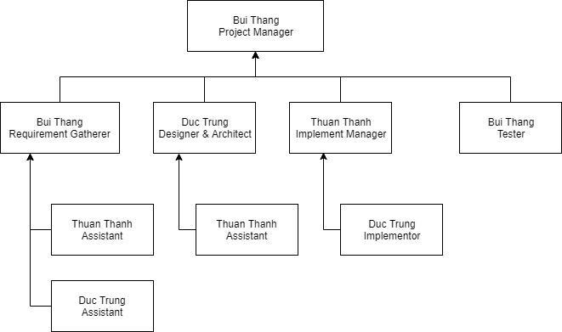
2. Project management
Team Structure

Slide 8
2. Project management
Responsibilities of team members
Person | Role
Bui Thang, Project Manager | Responsible for managing the overall Project Management discipline. Leads the extended Project Management Team.
Bui Thang, Requirement Gatherer | Responsible for gathering requirements, analyzing requirements, manage requirements.
Thuan Thanh, Requirement Gathering Assistant Duc Trung, Requirement Gathering Assistant | Assisting Requirement Gatherer fulfill works.
Duc Trung, Designer/Architect | Responsible for designing graphical user interface, system architecture.
Thuan Thanh, Design Assistant | Assisting Designer in designing Database.
Thuan Thanh, Implement Manager | Responsible for implementing system, maintaining system and fixing bugs.
Duc Trung, Implementor | Responsible for implement graphic user interface, assisting maintaining system.
Bui Thang, Tester | Responsible for testing the system released each iteration, reporting Implement Manager about bugs, giving Implement Manager comments.

Slide 9
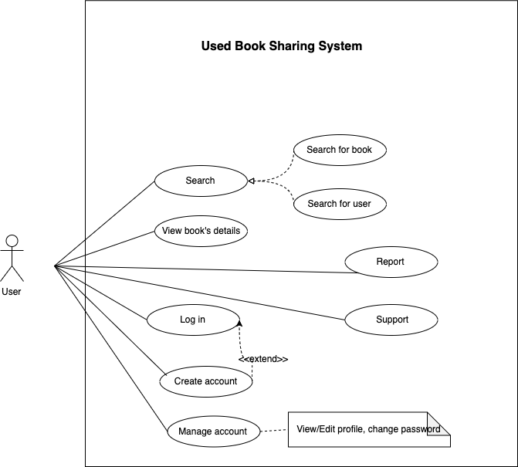
3. Software requirements
3.1 Use-case Model

Slide 10
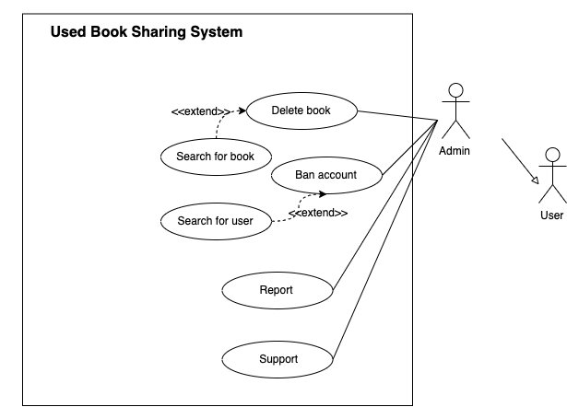
3. Software requirements
3.1 Use-case Model

Slide 11
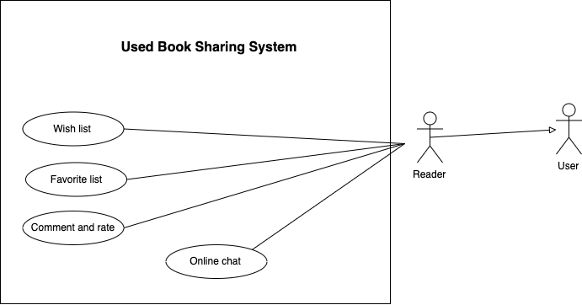
3. Software requirements
3.1 Use-case Model

Slide 12
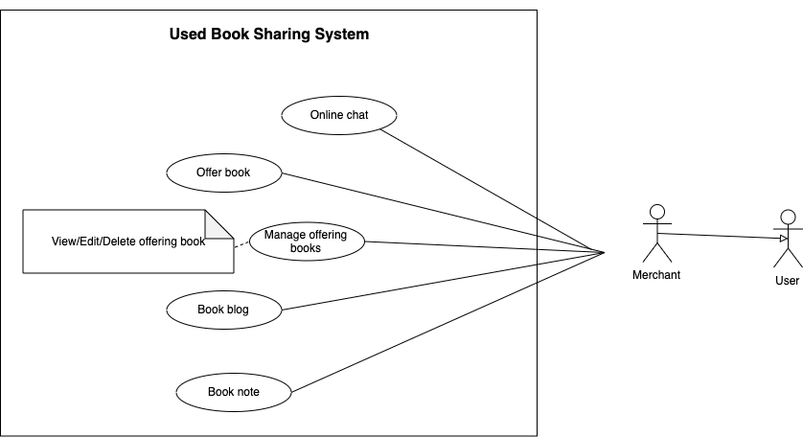
3. Software requirements
3.1 Use-case Model

Slide 13
3. Software requirements
3.2 Non-functional requirements
Requirement
Environment requirement | Personal computer or mobile device with an updated browser and Internet connection.
Login | Username and password need to be encrypted before being sent over Internet. User must be prevented from logging in for a certain time after many failed logging in.
Create account | User needs to confirm website policy before heading to create a new account.
Search for books | The time for searching for a book needs to be within 5 seconds. Result books have to be sorted by descending related order (most related book to least related book).

Slide 14
3. Software requirements
3.2 Non-functional requirements
Requirement
Book details | Book details must be placed at the center of screen and easy to see at least images of book and contact section.
Comment | Users’ comment is not longer than 200 characters.
Rating | Rate method must be one step and easy to complete such as clicking to number of stars.
Visit website | Home page must have a clear visible theme and have to be easy to use.

Slide 15
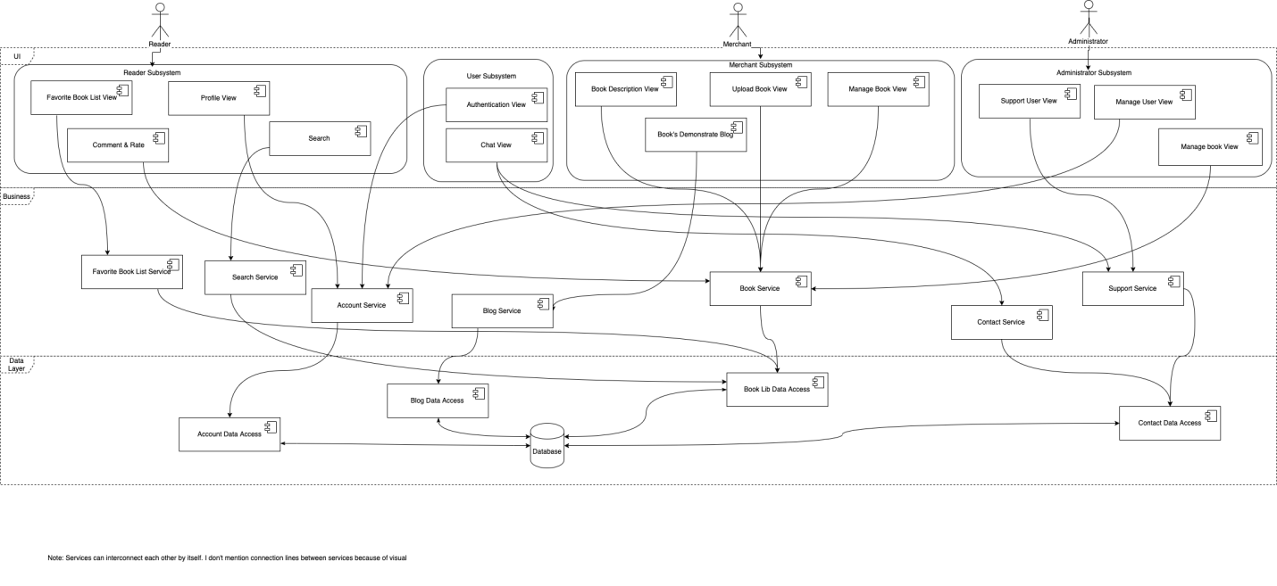
4. Analysis and design
4.1 Architecture

Slide 16
4. Analysis and design
4.2 Technologies
Technology | Use
Communication | Slack
View Engine | Express Handlebars
Client Side | HTML, CSS, Javascript
Server Side | Nodejs, Mysql
Design Model | Draw.io
Design UI | Adobe XD
Store Source Code | Github

Slide 17
5. Software testing
Test environment:
1 PC Server which includes database server for system.
1 PC client which have modern browser installed.
1 Mobile device client which have modern browser installed.
Internet or LAN network.
Software used: Google Chrome, Katalon

Slide 18
5. Software testing
Test plan:
Total main features to test: 5 features
week 1: search book
week 2: sign up, log in
week 3: upload, comment

Slide 19
5. Software testing
Test results:
ID | Feature name | test cases | Pass | Bugs
UC02 | search | 5 | 4 | 1
UC04 | Login | 6 | 6 | 0
UC05 | signup | 5 | 3 | 2

Slide 20
5. Software testing
Bugs:
Can't find book with additional spaces
Page keeps loading infinitely
Can't add book even provide full information
Can't access the uploaded book list
Page didn't show error message when comment fails.
Page didn't restrict the number of characters for a comment.
...

Slide 21
6. Demo

Slide 22
Thank you for watching

